Slide 1
AWS

Slide 2
What is AWS
Amazon Web Services, is a subsidiary of Amazon that provides on-demand cloud computing platforms and APIs to individuals, companies, and governments, on a metered pay-as-you-go basis.
It was founded on 3rd March 2006.

Slide 3
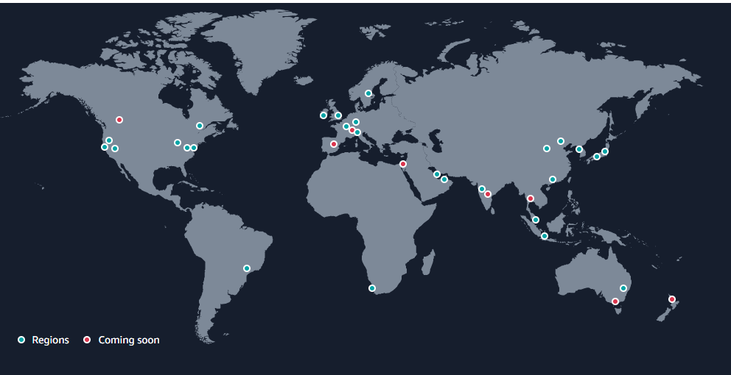
Region
Region is a separate geographic area.
Each region is completely independent and isolated from other region.
The AWS Cloud spans in 27 geographic regions around the world.
Regions in Australia, Canada, India, Israel, New Zealand, Spain, Switzerland, and Thailand.

Slide 4
Region
When you view your resources, you see only the resources that are tied to the Region that you specified.
This is because Regions are isolated from each other, and we don't automatically replicate resources across Regions.
There is a charge for data transfer between Regions.
An AWS account provides multiple Regions so that you can launch Amazon service instances in locations that meet your requirements.
Code | Name | Code | Name
us-east-2 | US East (Ohio) | ap-northeast-3 | Asia Pacific (Osaka)
us-east-1 | US East (N. Virginia) | ap-northeast-2 | Asia Pacific (Seoul)
us-west-1 | US West (N. California) | ap-southeast-1 | Asia Pacific (Singapore)
us-west-2 | US West (Oregon) | ap-southeast-2 | Asia Pacific (Sydney)
af-south-1 | Africa (Cape Town) | ap-northeast-1 | Asia Pacific (Tokyo)
ap-east-1 | Asia Pacific (Hong Kong) | ca-central-1 | Canada (Central)
ap-southeast-3 | Asia Pacific (Jakarta) | eu-central-1 | Europe (Frankfurt)
ap-south-1 | Asia Pacific (Mumbai) | eu-west-1 | Europe (Ireland)
me-south-1 | Middle East (Bahrain) | eu-west-2 | Europe (London)
me-central-1 | Middle East (UAE) | eu-south-1 | Europe (Milan)
sa-east-1 | South America (São Paulo) | eu-west-3 | Europe (Paris)
 |  | eu-north-1 | Europe (Stockholm)

Slide 5
How to choose right Region
Consider four main aspects when deciding which AWS Region to host your applications and workloads:
Latency: If your application is sensitive to latency, choose a Region that is close to your user base. This helps prevent long wait times for your customers.
Price: Due to the local economy and the physical nature of operating data centers, prices may vary from one Region to another. The pricing in a Region can be impacted by internet connectivity, prices of imported pieces of equipment, customs, real estate, and more. Instead of charging a flat rate worldwide, AWS charges based on the financial factors specific to the location.
Service availability: Some services may not be available in some Regions. The AWS documentation provides a table containing the Regions and the available services within each one. So, choose the region according to your service requirements.
Compliance: Enterprise companies often need to comply with regulations that require customer data to be stored in a specific geographic territory. If applicable, you should choose a Region that meets your compliance requirements.

Slide 6
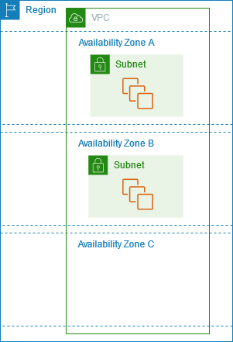
Availability Zone (AZ)
Availability Zones are multiple, isolated locations within each Region.
An AZ consists of one or more data centers with redundant power, networking, and connectivity.
The AWS Cloud spans 87 Availability Zones within 27 geographic regions around the world, with announced plans for 24 more Availability Zones and 8 more AWS.
The code for Availability Zone is its Region code followed by a letter identifier. For example, us-east-1a.

Slide 7
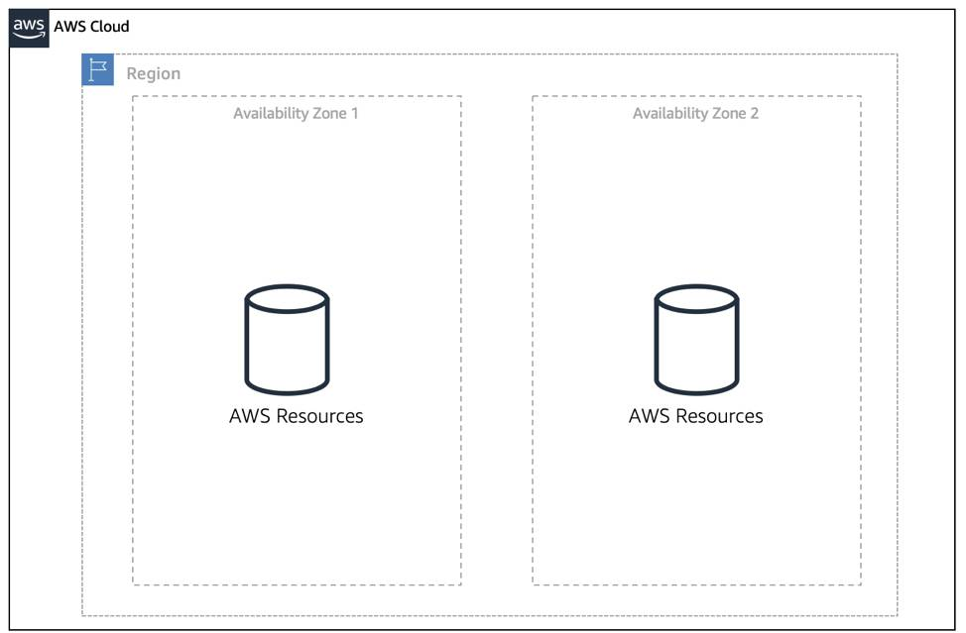
Availability Zone (AZ)
When you launch an instance, you can optionally specify an Availability Zone in the Region that you are using.
If you do not specify an Availability Zone, an Availability Zone for your instance is automatically specified.
To keep your application available, you need to maintain high availability and resiliency.
A well-known best practice for cloud architecture is to replicate across multiple AZs.
At a minimum, you should use two AZs. If one entire AZ fails, your application will have infrastructure up and running in at least a second AZ to take over the traffic.

Slide 8
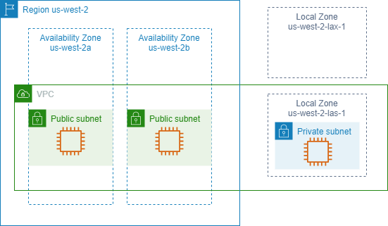
Local Zone (LZ)
LZ provide you the ability to place resources (computing, storage etc.) in multiple locations close to your end users.
A Local Zone is an extension of an AWS Region in geographic proximity to your users.
Local Zones have their own connections to the internet and support AWS Direct Connect, so that resources created in a Local Zone can serve local users with low-latency communications.
To use a Local Zone, you must first enable it.
The code for a Local Zone is its Region code followed by an identifier that indicates its physical location. E.g., us-west-2-lax-1 in Los Angeles.

Slide 9
Interacting with AWS
There are three different ways to use AWS services:
AWS Management Console: One way to manage cloud resources is through the web-based console, where you log in and click on the desired service. This can be the easiest way to create and manage resources when you first begin working with the cloud.
AWS Command Line Interface (CLI): The AWS CLI is a unified tool to manage AWS services. With just one tool to download and configure, you control multiple AWS services from the command line and automate them with scripts. The AWS CLI is open-source, and there are installers available for Windows, Linux, and Mac OS.
AWS Software Development Kits (SDKs): AWS Software Development Kits (SDKs) are open-source and maintained by AWS for the most popular programming languages, such as C++, Go, Java, JavaScript, .NET, Node.js, PHP, Python, and Ruby. Developers commonly use AWS SDKs to integrate their application source code with AWS services.

Slide 10
AWS Elastic Compute Cloud (EC2)
Amazon EC2 provides scalable computing capacity in the AWS cloud.
EC2 instance that allow users to rent virtual computers on which they can run their own application.
With the help of EC2 we can launch as many instance as we need, also configure security, networking and storage.
EC2 enable you to scale up and scale down instances.
Pre-configured templates of EC2 instances are available which are known as Amazon Machine Image.
We can create maximum of 20 EC2 instances in a region.
High Cost as compared to other pricing model.

Slide 11
AWS EC2 Instance Types
General Purpose: Balanced Memory & CPU
Compute Optimized: More CPU than RAM
Memory Optimized: More RAM
Storage Optimized: Low latency
High Memory: High RAM on Nitro system
Accelerated Computing/GPU: Graphics optimized

Slide 12
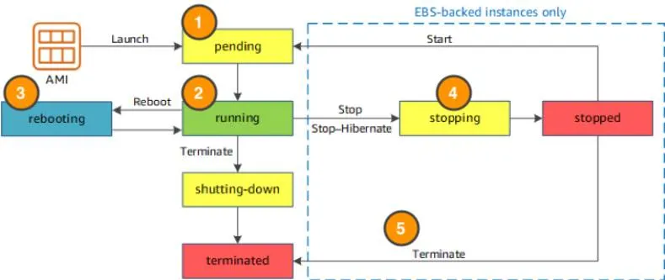
AWS EC2 Instance Life Cycle

Slide 13
AWS EC2 Instance Life Cycle
When you launch an instance, it enters the pending state (1). When the instance is pending, billing has not started. At this stage, the instance is preparing to enter the running state.
When your instance is running (2), it's ready to use. This is also the stage where billing begins. As soon as an instance is running, you are then able to take other actions on the instance, such as reboot, terminate, stop, and stop-hibernate.
When you reboot an instance (3), it’s different than performing a stop action and then a start action. Rebooting an instance is equivalent to rebooting an operating system. The instance remains on the same host computer and maintains its public and private IP address (Private IP address of a system is the IP address that is used to communicate within the same network. Using private IP data or information can be sent or received within the same network. Public IP address of a system is the IP address that is used to communicate outside the network.), and any data on its instance store.
It typically takes a few minutes for the reboot to complete. When you stop and start an instance (4), your instance may be placed on a new underlying physical server. Therefore, you lose any data on the instance store that were on the previous host computer. When you stop an instance, the instance gets a new public IP address but maintains the same private IP address.
When you terminate an instance (5), the instance store are erased, and you lose both the public IP address and private IP address of the machine. Termination of an instance means you can no longer access the machine.

Slide 14
AWS EC2 Storage Options
Two types of block store devices are available for EC2 instances:
Elastic Block Storage
Instance Storage

Slide 15
AWS Storage
There are five different storage services available in AWS:
Simple storage service (S3)
Elastic Block Storage (EBS)
Elastic File Storage (EFS): This storage system is used only for linux based system.
Glacier: Its cheaper version of S3, and now no more a separate service. Now it has become part of S3. Used for storing rarely used data.
Snowball: Used for data migration and these are portable big storage devices.

Slide 16
Block vs Object Storage
In Block storage, we divide the file/data to be stored in evenly sized blocks before it get stored.
Block storage does not require meta data. It just maintains the indexing information by maintaining the address of different blocks. What content is stored in those blocks does not have any significance.
Block storage is generally used for transactional database, structured database etc.
Block storage is used by AWS EBS.
In object storage, we store the complete file and does not divide it.
In object storage, we can store file of any type.
Object can be file of any type, meta data file, object global unique id.
Object storage can’t be mounted as drive. Its example are dropbox, facebook etc.
Object storage is used by AWS S3

Slide 17
Simple Storage Service (S3)
S3 is a storage for the internet.
It has a simple web service interface for storing and retrieving of any amount of data anytime from any where on the internet.
It is an object-based storage which can store any type of data, generally used to store unstructured data.
We can’t install operating system in S3.
S3 has a distributed data store architecture where objects are redundantly stored in multiple locations.
Data is stored in buckets.
A bucket is flat container of objects.
Maximum capacity of a bucket is 5TB.
You can create folders in the bucket but nesting of bucket is not possible.
Bucket ownership is non-transferable.
You can have up to 100 buckets per account.

Slide 18
Elastic Block Storage(EBS)
EBS is accessible to single EC2 instance only.
It is a block storage service which stores data in the form of equal size blocks.
Used when we need a high-performance storage service for a single instance.
Suitable for database type data that requires frequent read and write.
EBS volume behave like raw, unformatted external block storage device that you can attach to your EC2 instance.
Both EBS volume and EC2 instance must be in the same AZ.
An EBS volume data is replicated by AWS across multiple servers in the same AZ to prevent data loss resulting from single AWS component failure.

Slide 19
AWS EC2 Storage Options
Two types of block store devices are available for EC2 instances:
Elastic Block Storage (EBS)
Instance Storage (IS)
These two can be used as Root/Boot volume. But S3 can’t be used for this purpose.
Root/Boot volume is the place, where OS is stored.
Either EBS or IS is attached with EC2 instance as Root volume.
EBS backed EC2 instance means root volume is EBS.
IS backed EC2 instance means root volume is IS.

Slide 20
AWS EC2 Storage Options
Instance Storage:
IS is directly attached with EC2 instance while EBS is attached with EC2 instance through a network..
IS is faster than EBS as it is directly attached with EC2 instance.
IS is limited to 10GB per device while storage capacity of EBS is much larger.
IS is non persistent i.e., moment you terminate or stop EC2, data stored in this will be deleted while EBS is persistent storage means data stored in EBS will not be deleted by stop or reboot of EC2 instance. It get deleted only by termination of EC2 instance.
By default, an EC2 instance termination deletes the associated root volume.

Slide 21
AWS IAM (Identity and Access Management)
IAM is an AWS service that enables you to manage access to your AWS account and resources.
It also provides a centralized view of who and what are allowed inside your AWS account (authentication), and who and what have permissions to use and work with your AWS resources (authorization).
With IAM, you can share access to an AWS account and resources without having to share your set of access keys or password.
You can also provide granular access to those working in your account, so that people and services only have permissions to the resources they need.
For example, to provide a user of your AWS account with read-only access to a particular AWS storage service, you can granularly select which actions and which resources in that service they can access.

Slide 22
AWS IAM (Identity and Access Management)
IAM is global and not specific to any one Region. This means you can see and use your IAM configurations from any Region in the AWS Management Console.
IAM is integrated with many AWS services by default.
You can establish password policies in IAM to specify complexity requirements and mandatory rotation periods for users.
IAM supports MFA (multi factor authentication).
Any AWS customer can use IAM; the service is offered at no additional charge.

Slide 23
Virtual Private Cloud (VPC)
When working with networks in the AWS Cloud, you choose your network size by using CIDR notation.
Classless Inter-Domain Routing (CIDR) notation specify how many IP addresses you can have in the network.
X.Y.Z.M/N means N bits are fixed and you have 2^{(32-N}) number of IP addresses in your network.
In AWS, the smallest IP range you can have is /28, which provides you 16 IP addresses. The largest IP range you can have is /16, which provides you with 65,536 IP addresses.
E.g., 192.168.1.0/24 means we can have 256 IP addresses in our network.

Slide 24
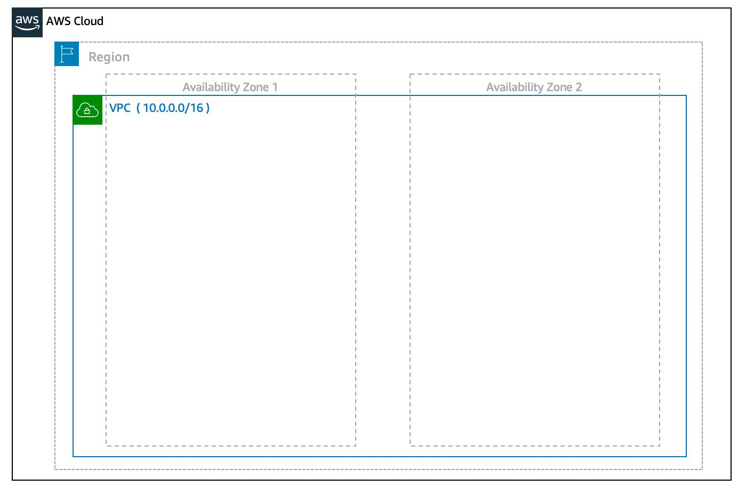
Virtual Private Cloud (VPC)
A VPC is an isolated network you create in the AWS cloud. When you create a VPC, you need to choose three main things:
The name of your VPC.
A Region for your VPC to live in. Each VPC spans multiple Availability Zones within the Region you choose.
An IP range for your VPC in CIDR notation. This determines the size of your network

Slide 25
Virtual Private Cloud (VPC)
A VPC is an isolated network you create in the AWS cloud. When you create a VPC, you need to choose three main things:
A VPC is confined to an AWS region and does not extend between different regions.
Once we create VPC, DHCP (Dynamic host configuration protocol), NACL (Network access control list) and security group will be automatically created.
Each VPC is logically isolated from other VPC on the AWS cloud.
Once the VPC is created, you can’t change primary CIDR.

Slide 26
Subnet
After you create your VPC, you need to create subnets inside of this network.
Subnets are smaller networks inside your base network.
Subnets are formed in AZ not in region and same subnet can’t be in two different AZ.
Two different subnets in a VPC can’t overlap.
The typical use case for subnets is to isolate or optimize network traffic. In AWS, subnets are used for high availability and providing different connectivity options for your resources.
When you create a subnet, you need to choose three settings.
The VPC you want your subnet to live in.
The Availability Zone you want your subnet to live in.
A CIDR block for your subnet, which must be a subset of the VPC CIDR block.
When you launch an EC2 instance, you launch it inside a subnet, which will be located inside the Availability Zone you choose.

Slide 27
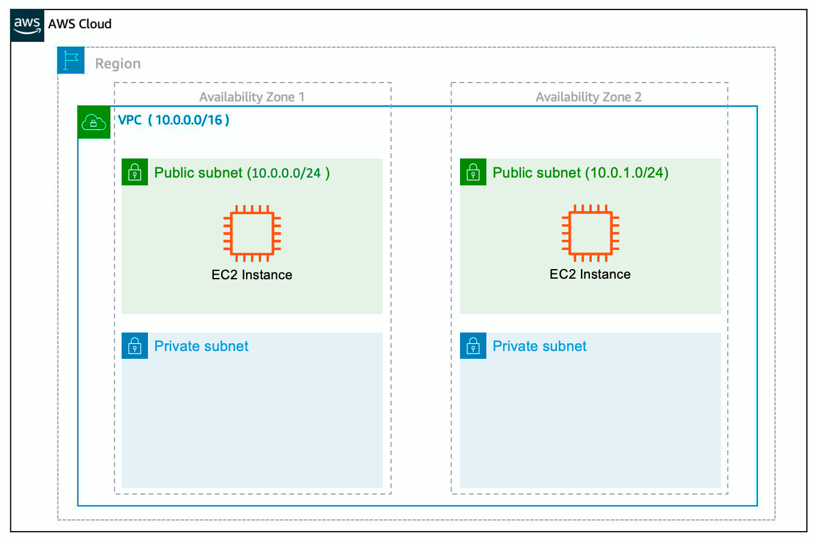
Subnet

Slide 28
Subnet
It’s important to consider that “everything fails all the time.” In this case, if one of these AZs fail, you still have your resources in another AZ available as backup. This will ensure high availability.

Slide 29
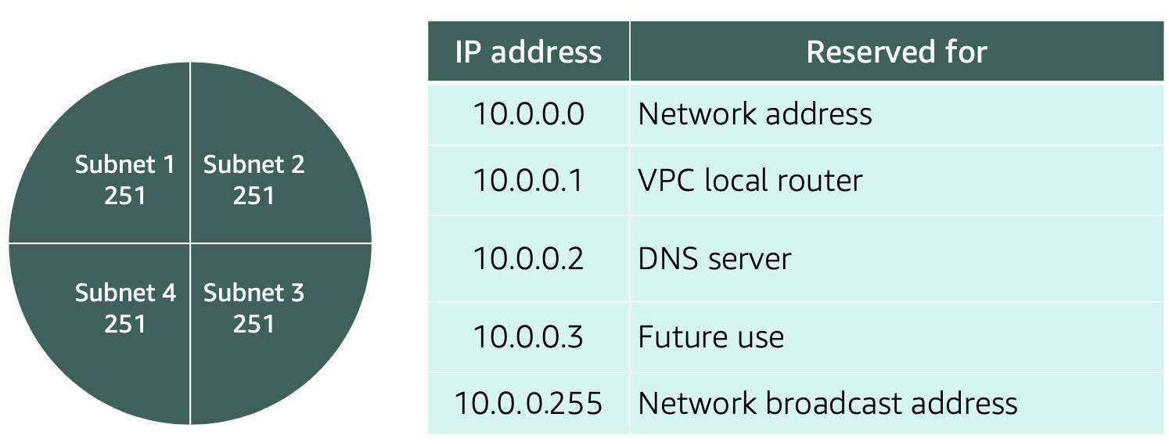
Subnet
For AWS to configure your VPC appropriately, AWS reserves five IP addresses in each subnet.
These IP addresses are used for routing, Domain Name System (DNS), and network management.
For example, consider a VPC with the IP range 10.0.0.0/22. The VPC includes 1,024 total IP addresses. This is divided into four equal-sized subnets, each with a /24 IP range with 256 IP addresses. Out of each of those IP ranges, there are only 251 IP addresses that can be used because AWS reserves five.

Slide 30
Subnet
Gateways
Internet Gateway (IGW)
To enable internet connectivity for your VPC, you need to create an internet gateway. Just as a modem connects your computer to the internet, the internet gateway connects your VPC to the internet (outside world).
Virtual Private Gateway
A virtual private gateway allows you to connect your AWS VPC to another private network

Slide 31
Steps in VPC creation
Create a VPC
Create a Subnet(s)
Create Internet Gateway
Create Route Table

Slide 32
VPC Routing
When you create a VPC, AWS creates a route table called the Main Route Table. It contains a set of rules, that are used to determine where network traffic is directed.
There are two main parts to Main Route Table.
The destination, which is a range of IP addresses where you want your traffic to go.
The target, which is the connection through which to send the traffic.
Route table associated with subnets are called custom route table. If custom route table is associated with subnet, then subnet does not use main route table.
By default, each custom route table you create will have the local route already inside it, allowing communication to flow between all resources and subnets inside the VPC.
For example, your application may consist of a frontend and a database. You can create separate subnets for these resources and provide different routes for each of them.

Slide 33
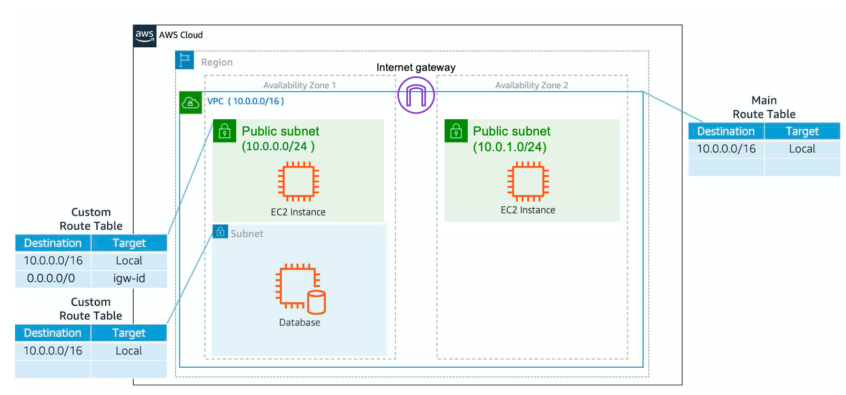
VPC Routing

Slide 34
Relational Database Service (RDS)
Amazon RDS enables you to create and manage relational databases in the cloud without the operational burden of traditional database management.
Amazon RDS supports most of the popular relational database management systems:
Commercial: Oracle, SQL Server
Open Source: MySQL, PostgreSQL, MariaDB
Cloud Native: Amazon Aurora
Amazon RDS is built off of compute and storage.
The compute portion is called the DB (database) instance, which runs the database engine. Depending on the engine of the DB instance you choose, the engine will have different supported features and configurations. When you create your DB instance, you choose the instance type and size.
DB instance uses Amazon Elastic Block Store (EBS) volumes as its storage layer.

Slide 35
DynamoDB
Amazon DynamoDB is a fully managed NoSQL database service that provides fast and predictable performance with seamless scalability.
With DynamoDB, you can create database tables that can store and retrieve any amount of data and serve any level of request traffic.
In DynamoDB, tables, items, and attributes are the core components that you work with. A table is a collection of items, and each item is a collection of attributes. DynamoDB uses primary keys to uniquely identify each item in a table and secondary indexes to provide more querying flexibility.
DynamoDB also offers encryption at rest, which eliminates the operational burden and complexity involved in protecting sensitive data.

Slide 36
CloudWatch
Amazon CloudWatch is a monitoring and observability service that collects data of different services.
CloudWatch provides actionable insights into your applications and enables you to respond to system-wide performance changes, optimize resource utilization, and get a unified view of operational health.
You can use CloudWatch to:
Detect anomalous behavior in your environments.
Set alarms to alert you when something’s not right.
Visualize logs and metrics with the AWS Management Console.
Take automated actions like scaling.
Troubleshoot issues.
Discover insights to keep your applications healthy.

Slide 37
Cloud Front
Latency is the delay in network communication. It shows the time that data takes to transfer across the network. Networks with a longer delay or lag have high latency, while those with fast response times have low latency.
Latency can be decreased by the following ways:
Using auto scaling of the servers at a single locations
This will improve the server response time but does not improve the latency occurring due to distance
By deploying servers at different locations in the world.
This will improve latency but causes extra headache and cost due to data base management at different locations and actual server deployment at those different locations.
CloudFront an AWS service can help in reduction of latency without causing any extra head and cost.
It is a fast content delivery network (CDN) service that securely delivers data, videos, applications, and application programming interfaces (APIs) to customers globally with low latency and high transfer speeds, all within a developer-friendly environment.

Slide 38
Cloud Front
Edge location is a site where data can be stored for lower latency. Often, edge locations will be close to high-population areas that will generate high traffic volumes.
At present in AWS, there are total 205 edge locations and 7 regional edge caches.
Main server where content is stored is called Origin.

